Slide 1
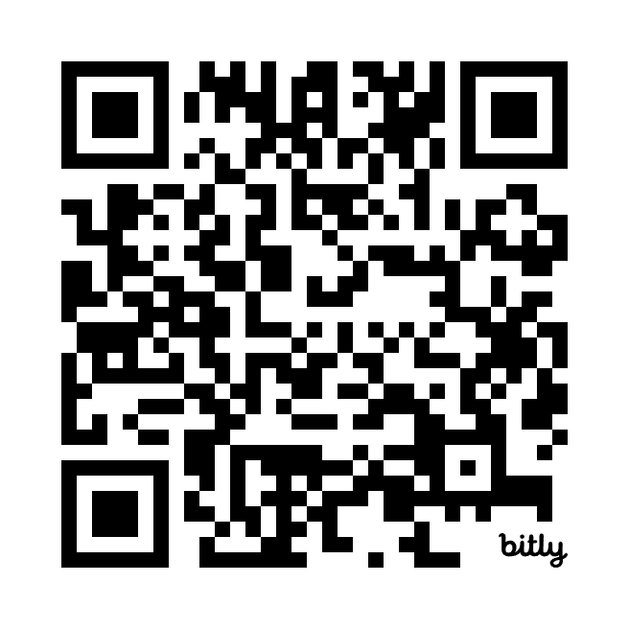
Focus Group
Community Safety in Cully
CAN is hosting a focus group for Cully residents. This focus group will discuss low-level crimes and safety in the Cully community.
Date: Tuesday, January 14, 2025
Location: in the Cully Neighborhood
Time: 5:30pm to 8:00pm
In Cully we are proud of our diversity. We are looking for a diverse group to participate in this focus group. We strongly encourage people from all backgrounds, languages, race, age, various level of ability, LGTBQ to sign up by using the following QR code.
Dinner, Childcare and interpretation will be provided!!
Up to 20 people representing the diversity in Cully will be selected to participate in this focus group. Participants will receive a $200.00 gift card from local businesses.
https://bit.ly/4eSJMCK

