Slide 1
PDX NA Backstory
1974, Office of Neighborhood Associations
40+ years later, Office of Community & Civic Life
94 volunteer-led neighborhood associations, connected to specific neighborhood boundaries, governed by City Code 3.96 (ONI Standards)
7 District Coalition Offices (DCO) receive city funds to support 94 NA’s
https://www.portland.gov/civic/myneighborhood/about-neighborhood-system
https://www.southeastexaminer.com/2016/11/history-of-portlands-neighborhood-associations/
https://www.wweek.com/news/city/2019/09/11/chloe-eudalys-neighborhood-war-the-populist-commissioner-hits-back-against-critics-who-say-shes-strangling-portland-democracy/
http://livableportland.org/2018/08/15/a-helpful-history-of-portlands-neighborhood-association-system/
Notes:
http://livableportland.org/2018/08/15/a-helpful-history-of-portlands-neighborhood-association-system/:
PROLOGUE
[In the 1960s] Portland was falling into a downward spiral of urban decay, sprawl, and the multiple problems stemming from car-centered development. Not wanting to follow the same pattern that characterized most North American cities, Portland has helped to spearhead a movement towards urban livability. With urban growth boundaries, quality public transportation, and broad-based citizen participation in everything from local and regional planning to neighborhood associations, Portland is at the forefront of a movement to create livable urban regions in North America…
PORTLAND CITY NEIGHBORHOOD ASSOCIATIONS
Portland’s Neighborhood Associations (NAs) are often cited as an example of the city’s strong tradition of participatory democracy.
NAs emerged in the 1950s and 1960s as loose coalitions which formed usually to in response to some change affecting the neighborhoods in question. For example, in Lair Hill, student renters and Jewish and Italian families opposed the South Auditorium urban renewal project that would have displaced them. In 1966, Northeast Portland applied to participate in the Model Cities program and a citizen’s planning board was appointed to the project. Meanwhile, in Northwest Portland, proposals to expand the Good Samaritan Hospital spurred neighborhoods to organize and became negotiators for plans that saved older, more established residential neighborhoods. In 1971, Southeast Portland neighborhoods were a key part of the movement that eventually stymied plans to build the Mount Hood Freeway.
There were several reasons for the increased involvement among neighborhoods. Older neighborhoods were reacting to pressure by development interests. A change in political climate in the 1970s meant new city leaders were not tied to old planning practices favored by their old-school, technocratic predecessors. There were increased requirements for citizen participation in federal/state programs, such as, among other things, Senate Bill 100.
In 1972, then-Mayor Terry Schrunk convened the District Planning Organizational Task Force to explore the idea of a city mechanism for neighborhood and district citizen participation (in other words, to formalize and legitimize neighborhood involvement in the political process). The task force recommended three principles: a two-tiered structure of both Neighborhood Planning Organizations (NPOS) and DPOs (district planning organizations) be established. Both tiers were to be involved in planning for both physical and social issues, and this structure should have some real authority in City Council.
In 1973, voters elected Neil Goldschmidt, who was a strong advocate for increasing the power of neighborhood associations. He proposed a Bureau of Neighborhood Organizations with a budget of 104,000 dollars, and this proposal became an ordinance. The first draft of the ordinance proposed a system of both NPOs and DPOs when issues emerged concerning more than one neighborhood’s jurisdiction. A second draft ordinance addressed those concerns by the ONA (Office of NAs), created to coordinate among the NAs, which were volunteer-run.
In 1974, the city passed a plan to try out district field offices in three areas of the city where federal resources for this purpose were not available. The ordinance was revised again in 1975 to replace the process of the city’s recognition of NAs with the requirement that they meet minimum standards, ie banning discrimination, written grievance/dissent procedures, and NA by-laws be on file with ONA, and that both the ONA and District Office was to support/enhance the NAs’ work.
Under the plan, city agencies were responsible for notifying neighborhood associations 30 days before a decision affecting a NA, including NAs in all planning efforts affecting neighborhood livability, and making sure the plans recommended by NAs would have a public hearing, and any changes had to be sent to the NA. The NA in turn was responsible for notifying city agencies about planning efforts, sharing info and cooperating with city agencies.
In the NA system’s early years, a major achievement was getting neighborhoods involved with the city’s budget process. This meant the bureaus were asked to be accountable if neighborhood input didn’t appear in the bureau’s budget. By 1979, there were 60 active NAs in Portland. There were neighborhood mediation programs offered through the ONA and focused on disputes between neighbors, ie, tenants and landlords (and later, other issues such as crime prevention and safety).
Since these early years, the system has undergone changes and some difficulties. The recession brought public expenditures under increasing scrutiny. By 1984, there were increasing conflicts between the ONA and district coalitions and between districts. The last 13 years has seen a reorganization and re-evaluation of the purpose and future direction of the NA program.
https://www.southeastexaminer.com/2016/11/history-of-portlands-neighborhood-associations/:
The first organized neighborhood system grew up around the need for social services during the depression. Their activities were organized in small geographic areas usually using the boundaries of a neighborhood school.
This drew residents closer together as they got involved in helping their neighbors. These organizations lasted through the post war redevelopment period and into the 1950s.
At the beginning of the 1960s, there were no official neighborhood associations except for a few social clubs in well-to-do neighborhoods. However there were still many people in need, especially in deteriorating inner city neighborhoods.
This was a national issue across the country, so the Lyndon Johnson administration instituted the “War on Poverty.” One of the key components was the “Model Cities Program”.
begun in NE Portland’s African American communities in the mid 1960s. Federal requirements for the assistance dictated that decisions about local actions must include the people in the neighborhoods. This was the beginning of Portland’s official neighborhood associations.
The Portland Development Commission (PDC), the city’s Urban Renewal agency, became the official manager of the work.One of the things that neighborhoods wanted were area plans to help identify and justify broader issues needing attention.
After much talk, study, and work, the city decided to include the neighborhoods of Buckman, Sunnyside, Hosford Abernathy, and Richmond. The Portland Action Communities Together (PACT), todays Impact NW, worked with PDC to create SE Uplift in 1968.
Factors:
the commission form of government was a rather insular and the public was not able to have a voice in many important decisions.
State Highway Division’s desire to continue building freeways in the center of Portland as I-405 and the I-5 freeways had been built through major sections of the inner city.
State Highway Commission that Harbor Drive, a four-lane throughway similar to today’s McLaughlin or Barbur Boulevards, should be torn up and replaced by a centrally located city park
https://www.portland.gov/civic/myneighborhood/about-neighborhood-system:
By creating the Office of Neighborhood Associations, the City was establishing a direct channel for neighborhood associations to engage in City decision-making, determine neighborhood needs, and represent neighborhood interests in land use and development decisions.
40+ years later, expanded our support to include not just neighborhood associations but culturally specific organizations and non-profit organizations. We also changed our name to the Office of Community & Civic Life
providing support the work of Portland’s 95 volunteer-led neighborhood associations. We believe that a neighborhood association is one way that neighbors can organize and address important issues within their neighborhood. Neighborhood associations also play a role in creating a sense of community and belonging.
Some neighborhoods bigger/smaller
Some NAs active/not
https://www.wweek.com/news/city/2019/09/11/chloe-eudalys-neighborhood-war-the-populist-commissioner-hits-back-against-critics-who-say-shes-strangling-portland-democracy/:
A scathing 2016 audit of the city's Office of Neighborhood Involvement, which oversees neighborhood associations, prompted Mayor Ted Wheeler to target the bureau for an overhaul. The audit found ONI was failing to engage a broad swath of Portlanders and that they felt a growing sense of alienation. "Residents are increasingly pessimistic about their ability to influence city decisions," the audit said.

Slide 2
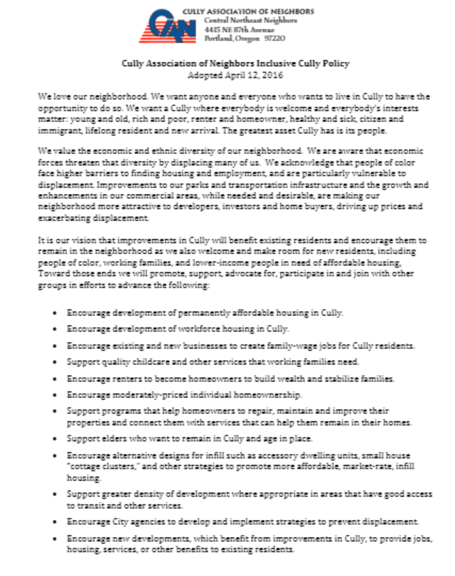
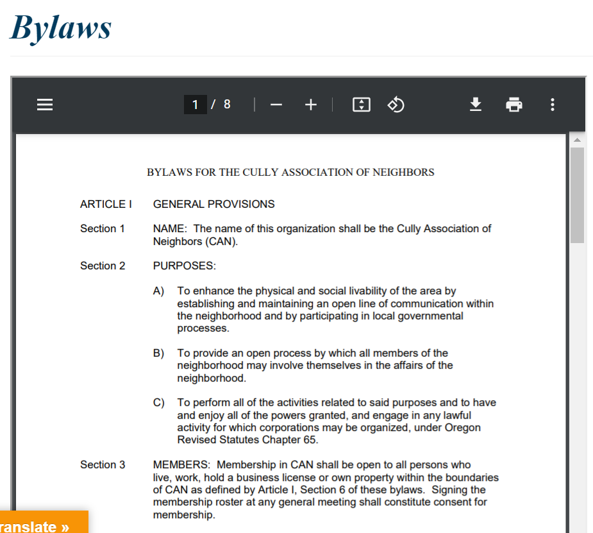
CAN Backstory
http://www.cullyneighbors.org/about/
http://www.cullyneighbors.org/bylaws/
http://www.cullyneighbors.org/inclusive-cully-policy/
Notes:
http://www.cullyneighbors.org/inclusive-cully-policy/

Slide 3
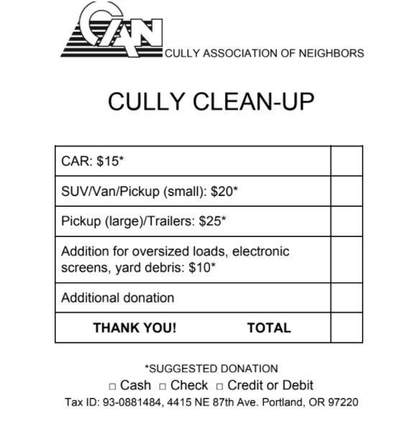
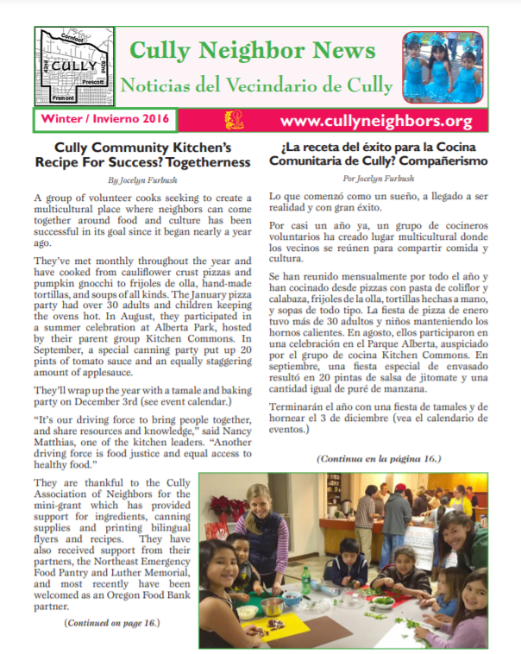
You may have seen
Cully Cleanup @ Trinity Lutheran
Summer for All
Print newsletter
CNN grant program
http://www.cullyneighbors.org/newsletter/newsletter-archive/

Slide 4
You may not have seen
Letter of support to PPS for Rigler Principal turnover
Monetary support for Rigler Reading Program
Letter of support to PBOT against street improvement requirements for childcare business at Morningstar Church
Letter of support to PBOT for preserving trees at International Grove
Letter of support to City for Shelter-to-housing initiative
Promoting donations to Living Cully Renter Relief Fund
Testimony to City in support of DOZA guidelines
Endorse/support event in opposition to Zenith tar sands facility
Notes:
Cully Community Tax Increment Financing District Seven organizations, including Living Cully propose a TIF to generated approximately $100 million in funds over a 20-year period, focused on preventing displacement of people of color and low-income people in Cully CAN becomes one of community sponsors, joins Living Cully development team, endorses Preliminary Plan and also recent request to Prosper Portland for $2.5 million to front-load TIF activities. Presentations made to CAN Board and to CAN general meetings.
Principal retention at Rigler Elementary School Turnover of principals at Rigler school has been excessive. Letter in support of Rigler PTA request to Portland Public Schools to remedy the problem is requested. CAN Board approves letter.
Reading Program at Rigler school CAN is requested to provide partial funding for the Padres Unidos reading program at Rigler. CAN Board approves funding. Presentation is also made at CAN General Meeting.
Childcare business at Morningstar Baptist Church This child care business wanted to improve its facilities but faced prohibitive street improvement costs required by PBOT. CAN Board approved letter to PBOT in favor of reducing requirements and associated costs to this business.
Shelter-to-Housing initiative City of Portland Shelter-to Housing Ordinance. Changes city zoning code to allow for outdoor villages, and instructs city bureaus to identify city owned properties that potentially used for outdoor shelters. CAN Board approves letter of support. City adopts code in April 2021.
Rent relief in Cully Neighborhood CAN Board discusses possible contributions to this problem. CAN Board approves funds to Renters Relief Program administered by Living Cully.
City of Portland Design Overlay Guidelines (DOZA) CAN Land Use Committee requested approval of testimony to City Council supporting the DOZA guidelines which were intended to remove barriers to construction of affordable housing among other objectives. The CAN Board approved the testimony, which was delivered, and the guidelines were subsequently adopted.
Zenith tar sands facility Support event by Columbia Riverkeepers and others to oppose Zenith tar sands facility and oil trains through the pacific NW and Portland. CAN Board approves support for the event.
Preserve International Grove Friends of Trees requested support for preserving a large grove of trees at NE 42nd and Lombard from a PBOT bridge improvement. The CAN Board approved a letter of support and involvement in the effort. PBOT subsequently reduce the potential damage to the trees.

Slide 5
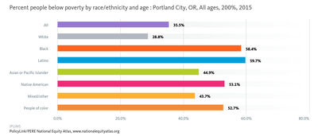
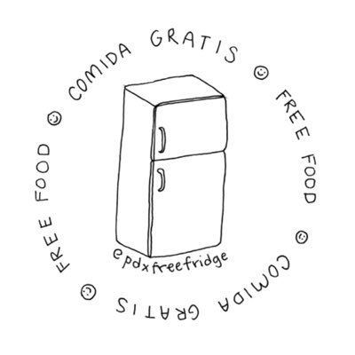
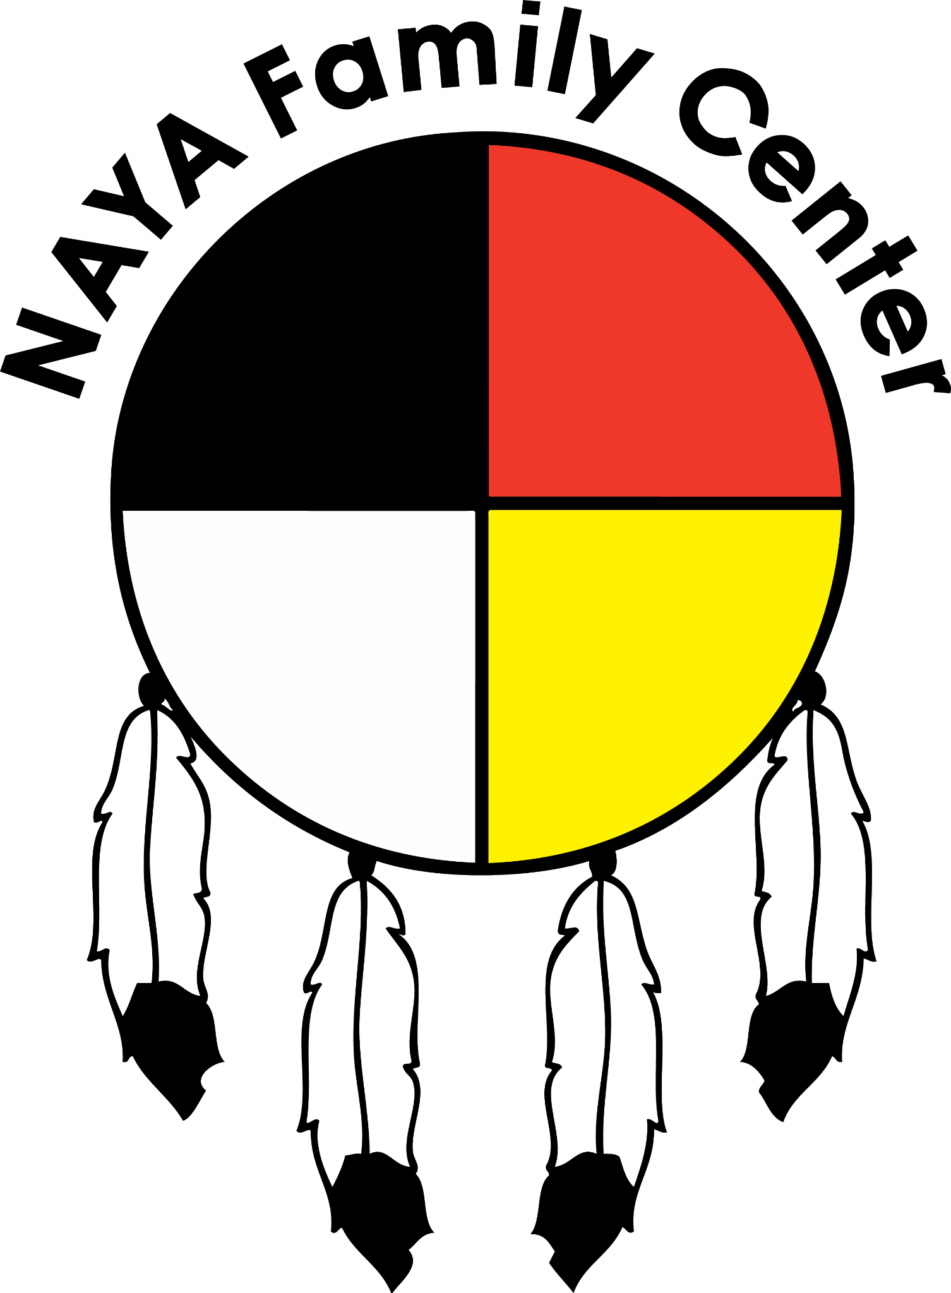
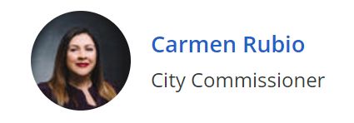
You may not have seen
Mutual Aid
What’s in a name?
Notes:
Portland Fruit Tree Project Tara and Kenja Bettis present information about fall fruit harvest, winter tree care and initiatives based in Cully. Presentation at CAN General Meeting
Transitional micro-villages to support homeless We Shine, a Portland non-profit, seek to site pods in micro-village sites, and provide wrap-around services to homeless populations. Presentation at CAN General Meeting.
Affordable Housing Loulie Brown, Sabin Community Development Corp., and Vivian Satterfield, Director of Strategic Partnerships for Verde make presentation. Presentation to CAN General meeting.
City of Portland Anti-Displacement Plan Staff from the City of Portland Bureau of Planning and Sustainability present latest updates to plan. Presentation
Mutual Aid Mutual Aid-What Does it Mean to You. Speakers: Mira Ayala, Leaven Community; Jessica Olivero, PDX Free Fridge; Elle Stuckey Brown Hope, Black Resilience Mutual Aid Presentation made at CAN General Meeting.
Gun Violence Commissioner Susheela Jayapal, District 2 Multnomah County shares recent budget approval and upcoming programs being worked on Presentation made at CAN General Meeting.
Portland city charter reform
A member of the Portland Charter Review Committee made a presentation regarding possible recommendations for a wide range of roles, responsibilities and operation of the Portland elected officials and city government.
Disaster relief assistance Portland Disaster Relief/Resiliency Relief described how an organized cargo bike program could aid in providing supplies and relief in a natural disaster situation. Presentation made at CAN General Meeting.

Slide 6
How we work
CAN general membership = anyone living, renting, or owning a business in Cully
Volunteer board, elected by CAN general members who show up to the meeting in which we hold elections (traditionally April)
Set agenda and program for general member meetings
Vote on letters of support
Build relationships with other organizations in Cully and across the city
Next election is April
All board officers are 1-year terms, current officers must re-run each year
Board members-at-large are 2-year terms, at least 3 will be up up for election

Slide 7
How can CAN improve?
Make more space for others | Who is under-represented?
“Right-size” volunteer roles | How can we create a ‘sustainable’ organization?
Support for advocacy in Cully | What neighborhood issues are under-represented?
Notes:
Create more opportunities (multi-generational, multicultural)
Communications: meets every 4th Friday at 5pm (typically the same week as the board meeting)
Meetings: ???
Admin:

